Slide 1


BIKE-SHARE DATA ANALYSIS · CHICAGO, IL
Cyclistic
Bike-Share
Data Analysis
Turning Casual Riders into Annual Members
— A Data-Driven Strategy
5,824
Bikes in Fleet
Prepared by Younggi Kim
Google Data Analytics Capstone · 2026
692
Stations · Chicago
2016 - 2025
Ride Data Analyzed

Slide 2
Executive Summary
CYCLISTIC BIKE-SHARE · KEY FINDINGS AT A GLANCE
FLEET & NETWORK
DATA SCOPE
5,824 bikes across 692 stations in Chicago — annual members drive significantly more revenue than casual riders.
10 Years of ride data(2016-2025) were analyzed to understand how annual member and casual rider behaviors differ and evolve.
01
02
KEY INSIGHT
RECOMMENDATIONS
Casual riders increasingly behave like members – showing more weekday, commute-time, and short-duration trips.
Three data-backed strategies developed to convert casual riders into paying annual members.
03
04
CYCLISTIC BIKE-SHARE · GOOGLE DATA ANALYTICS CAPSTONE
Prepared by Younggi Kim

Slide 3
COMPANY OVERVIEW
KEY FACTS AT A GLANCE
Four pillars that define the Cyclistic business model
Background
FLEET SIZE
STATION NETWORK
About Cyclistic — Chicago's city-wide bike-share network
5,824 Bikes
692 Docking Stations
Traditional, reclining, hand tricycle, and cargo options
Leisure & Daily Commuting
Spread across Chicago
Unlock from one station & return to any other station
OLD STRATEGY
NEW REVENUE STRATEGY
Expand Casual & Annual Members
Annual Members
Building general awareness
Broad consumer segment & Flexible pricing plans
Generate higher long-term profitability
Cyclistic launched in 2016 and has grown to become one of Chicago's most recognizable mobility brands, offering accessible transport across the city.
Flexible pricing options — single-ride, full-day, and annual memberships — serves diverse rider needs, but sustainable growth depends on converting casuals to members.

Slide 4
STRATEGIC GOAL
“
Design marketing strategies aimed at converting casual riders into annual members.
”
Director of Marketing Lily Moreno has identified this conversion as the primary lever for future growth. Increasing the proportion of annual members will maximize long-term profitability and deepen customer loyalty.
Lily Moreno — Director of Marketing, Cyclistic
CYCLISTIC BIKE-SHARE · GOOGLE DATA ANALYTICS CAPSTONE
Prepared by Younggi Kim

Slide 5
THE KEY QUESTION
How do annual members and casual riders use Cyclistic bikes differently?
THE KEY TASKS
Analyze Cyclistic’s historic trip data to identify behavioral trends across rider types
Illustrate visualization of key findings to serve as the evidence base for executive approval
Provide top tree recommendations for Cyclistic’s membership growth strategy
CYCLISTIC BIKE-SHARE · GOOGLE DATA ANALYTICS CAPSTONE
Prepared by Younggi Kim

Slide 6
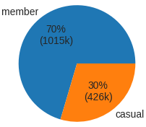
ANALYSIS CONTEXT
Factors Shaping the Analysis
Data overview and Analysis Tools
Data Privacy Issue and Limitations of Analysis
Source : Cyclistic historical trip data (2013-2026)
Cyclistic’s trip data does not include any personally identifiable information due to strict privacy regulations.
Format : Multiple CSV files with varying structures(monthly/quarterly)
Trip records cannot be linked to individual customers, credit card numbers, home addresses, or demographic profiles.
Data Consistency Issue:
Column names vary across years and user-type change over time
VS
No Customer-Level Segmentation — Because rider identities are not available, the analysis cannot determine.
Data Formatting and Missing Issue:
Timestamp formats differ and some missing data such station names
Behavior Without Motivation —The dataset captures what riders do, but not why. No information about rider motivations and satisfaction levels.
Analysis Tools: Jupyter Notebook with Python Technology
Jupyter Notebook with Python is ideal for exploring messy, multi‑year datasets through interactive, step‑by‑step analysis and data visualization.
Ex) 70% member trips vs. 30% casual trips(2016 Q3 Data)
We cannot conclude whether members ride more because there are more members, or because each member rides more frequently.
CYCLISTIC BIKE-SHARE · GOOGLE DATA ANALYTICS CAPSTONE
Prepared by Younggi Kim

Slide 7
Consideration to Analysis
CYCLISTIC BIKE-SHARE · KEY FOCUSES for Analysis
Usage Volume
PRODUCT CONTEXT
LOCATION CONTEXT
Bicycle usage in highly seasonal and strongly influenced by weather conditions.
02
Chicago experiences long and harsh winters, which significantly affect bike-share activity.
Q1
Q2
Q3
Q4
Quarter-based segmentation is the most appropriate.
— Year-level cannot capture seasonal variation, and moth-level is too granular.
The analysis focuses primarily on Q2 and Q3, especially Q3.
— When ridership is stable and weather effects are minimized.
TIME CONTEXT
ANALYTICAL FOCUS
The dataset spans 2016 to the present, a period that includes the covid-19 pandemic.
The business goal is to convert casual riders into annual members.
A long-term trend analysis is necessary.
— to understand how rider behavior evolved before, during, and after the pandemic.
The analysis must center on user type differences.
— to identify conversion opportunities and support execute decision-making.
04
CYCLISTIC BIKE-SHARE · GOOGLE DATA ANALYTICS CAPSTONE
Prepared by Younggi Kim

Slide 8
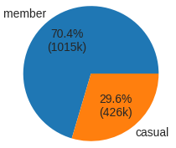
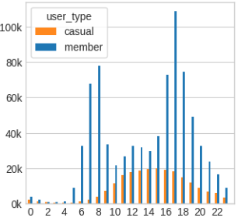
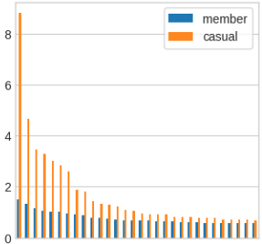
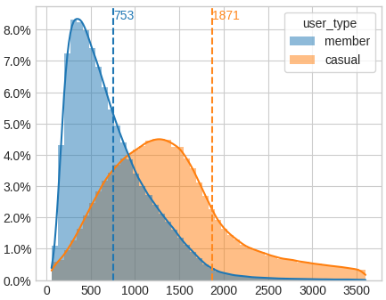
BEHAVIORAL ANALYSIS
Rider Behavior in Q3 in Year 2016
Casual Riders
Annual Members
LEISURE-ORIENTED SEGMENT
COMMUTER-ORIENTED SEGMENT
Casual riders spike on weekends
Member show stable weekday usage
Casual riders peak in afternoon
VS
Member peak at 6-9 AM and 4-6 PM – Commute hours
Casual riders start near tourist or lakeside locations
Members start office-dense areas
Concentrated pattern – 34% trip started within the Top 10 stations
Even usage pattern – 10% trip started within the Top 10 stations
Longer average ride duration – 31 minutes per trip
Shorter average ride duration – 13 min average per ride
Bike Usage by Day of Week
Bike Usage by Time of Day(Weekday Only)
Top 30 Starting Station(Proportion %)
Ride Duration Distribution with Average
(13mins)
(31mins)
Top 10 Starting Station
Member : 10.6%
Casual : 33.8%
High
Mid
Low
Mon
Tue
Wed
Thu
Fri
Sat
Sun

Slide 9
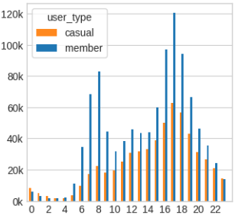
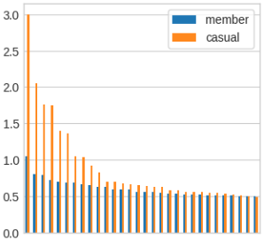
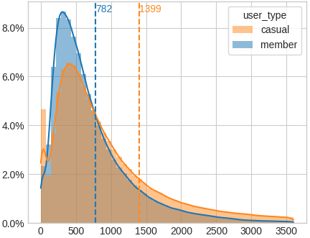
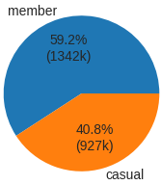
BEHAVIORAL ANALYSIS
Rider Behavior in Q3 in Year 2025
Casual Riders
Annual Members
LEISURE-ORIENTED SEGMENT WITH DIVERSE USSAGE PATTERN
COMMUTER-ORIENTED SEGMENT WITH WORK-LIFE BALANCE
Weekday usage increased, but weekends still peak
Members show stable weekday usage with weekend usage increasing
Clear rise in casual riders commuting around 8 AM and 5 PM
VS
Members still peak during commute hours, but afternoon usage also increased.
Casual riders start near tourist or lakeside locations
Members start in office-dense areas with wider choices.
More diverse usage – 15% trip started within the Top 10 stations
Even usage pattern – 7.3% trip started within the Top 10 stations
Ride Duration steadily decreased – 23 min per trip
Minimal change in average ride duration - 13 min average per ride
Bike Usage by Day of Week
Bike Usage by Time of Day(Weekday Only)
Top 30 Starting Station(Proportion %)
Ride Duration Distribution with Average
(13mins)
(23mins)
High
Top 10 Starting Station
Casual : 15.1%
Member : 7.3%
Mid
Low
Mon
Tue
Wed
Thu
Fri
Sat
Sun

Slide 10
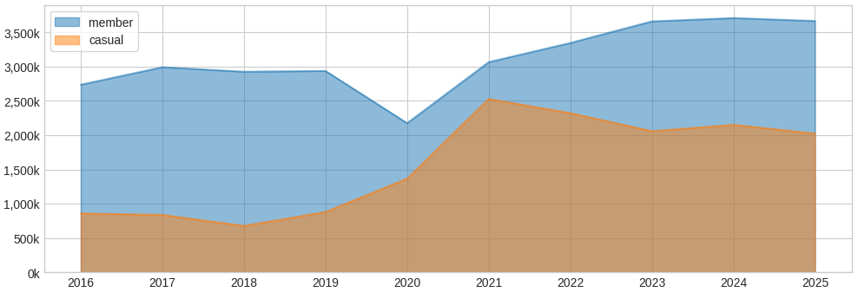
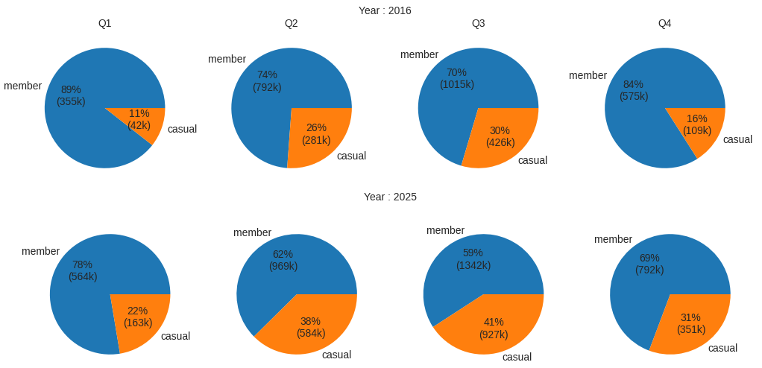
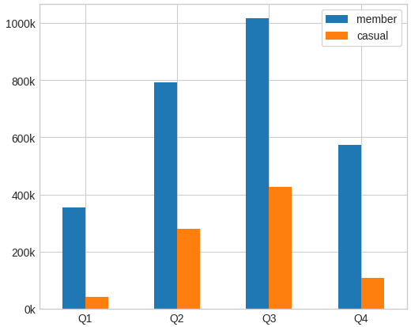
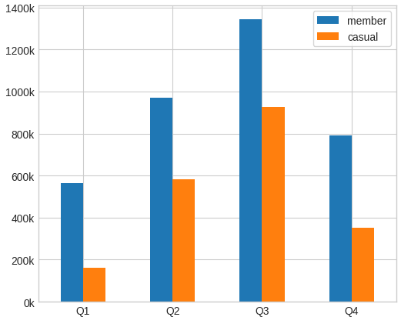
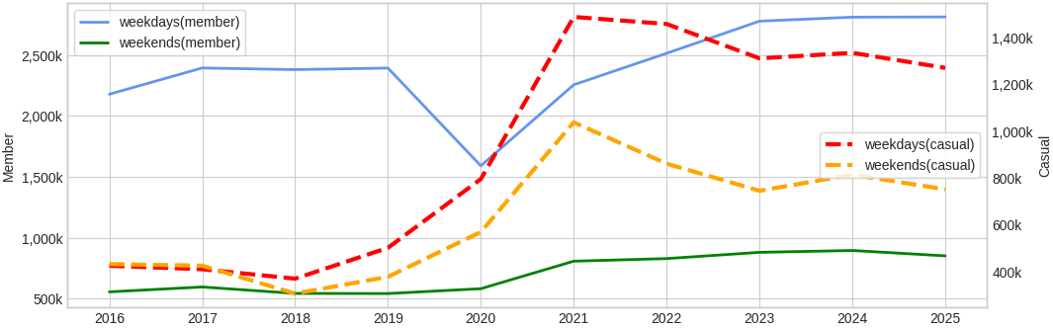
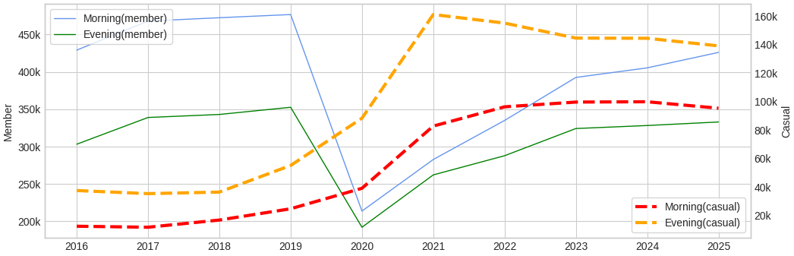
TRENDS ANALYSIS
Rider Usage Trends by Years(2016-2025)
Rides Volume Trends by Year
Quarterly Rides Volume Comparison: 2016 vs 2025
3,666,535
2,925,926
3,066,058
32%
2,736,869
2,529,005
2,175,108
2,024,246
1,366,575
858,474
880,637
12%
Member ridership dropped sharply(-25%) during the 2020 pandemic, recovered in the following years, and has grown steadily since.
Casual ridership surged starting in 2020 (+55% in 2020, +85% in 2021) and remaining high through 2025.
10-Year Growth: Members +34% (2.7M -> 3.7M), Casual Riders +136% (0.9M -> 2M).
Strong seasonality: low usage in Q1 and Q4, peak usage in Q2 and Q3(highest in Q3)
Casual rider share doubled in winter: Q1(11% -> 22%), Q4(16% -> 31%)
Summer increases (->40%, net by +10%) are also notable: Q2(26% -> 38%), Q3(30% -> 41%)
Rides Volume Trends by Year(Weekdays Vs. Weekends)
Weekday Commute-Time Ride Volume Trends (Morning 7-9 AM, Evening 5-6 PM)
2,813,685
138,936
1,271,898
429,092
426,043
2,179,574
99,751
303,062
332,845
753,348
425,622
37,485
432,852
5852,850
12,448
557,295
Weekday casual ridership grew dramatically by 200%(0.43M->1.27M), far exceeding the weekend growth of 74%(0.43M->0.75M).
Weekday member ridership increased by 30%(2.18M->2.81M), lower than the weekend growth of 53%(0.56M->0.85M).
Based on weekday data(Mon –Fri), focusing on morning(7-9 AM) and evening(5-6 PM).
Morning casual ridership grew 670% (0.01M->0.10M), evening casual ridership grew 271% (0.04M->1.4M) — both far exceeding the overall weekday casual growth of 200%.
Morning member ridership remained unchanged: evening ridership increased by 10%(0.3M->0.33M).

Slide 11
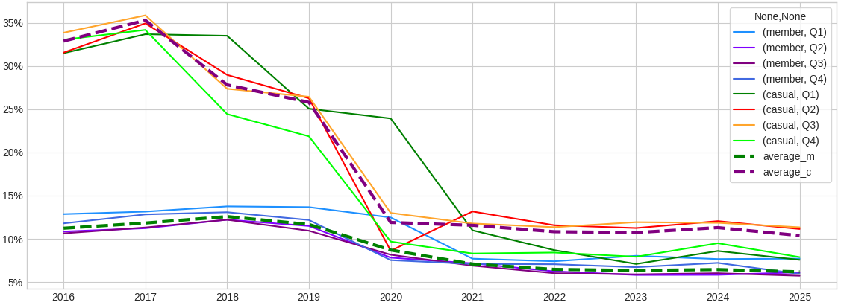
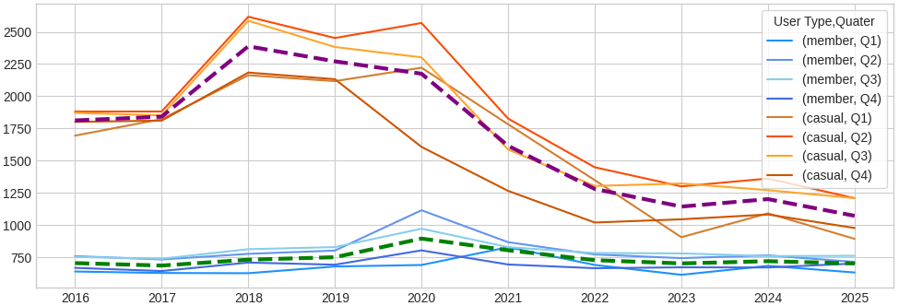
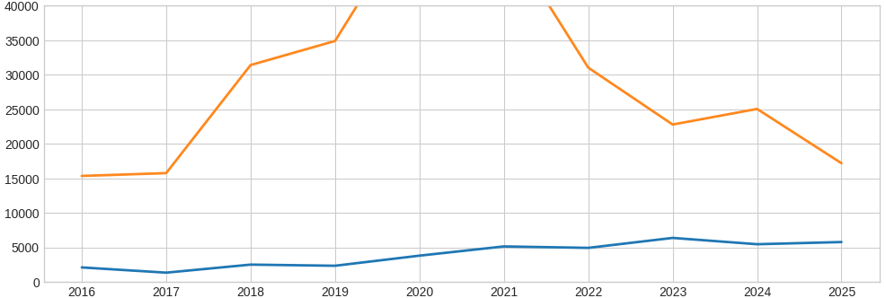
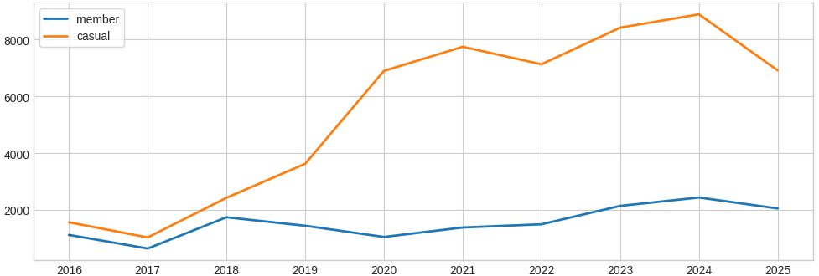
TRENDS ANALYSIS
Rider Usage Trends for 10 Years(2016-2025) – Continued.
Top 10 Starting Station Trends by Year(Proportion %)
Average Ride Duration Trends by Year
35%
Seconds
33%
28%
26%
1,812
11%
12%
1,072
10%
705
702
6%
Casual riders’ Top 10 starting-station share slightly increased in 2017 and begin declining in 2018(-7%).
The share dropped sharply during the 2020 pandemic (-14%) and remaining low through 2025(10%).
Annual members’ Top 10 starting-station share decreased over the years: 11%(2016) -> 6.0%(2025).
Member’s avg ride duration remained stable over time, with a slight fluctuation during the pandemic.
Casual riders’ avg ride duration rose sharply in 2018(+30%) and declined after the pandemic(-26%, -21%).
Overall, casual riders’ avg ride duration decreased 41%, from 1,812 seconds(2016) to 1,072 seconds(2025).
Mid Term (2 – 8 hours) Ride Volume Trends by Year
Long Term(Over 8 hours) Ride Volume Trendy by year
8,893
6,918
15,341
17,179
5,777
1,566
2,053
2,105
1,122
Mid-term(2-8 hours) ride volume for casual riders increased sharply up to the pandemic period.
Volume declined afterward but still show +12% increase 15,341(2016) to 17,179(2025).
Mid-term ride volume for members fluctuated but increased steadily overall, more than doubling(2.7x), rising from 2,105 -> 5,777.
Long-term(over 8 hours) ride volume for casual riders increased significantly overall, rising 342%.
These rides include extremely long durations(over one day): 6,153 rides in 2024 and 4,762 rides in 2025.
Long-term ride volume for members fluctuated over time and ultimately doubled, also including over-one-day durations: 1,443 rides in 2024 and 1,014 rides in 2025.

Slide 12
Why Casual Riders Can Be Converted to Annual Members?
CYCLISTIC BIKE-SHARE · CONCLUSION & KEY INSIGHTS
BEHAVIOR PATTERN
LOCATION USAGE
Casual Riders Now Behave More Like Commuters
Casual Riders Use the Network More Broadly
Morning casual ridership up 670%; evening up 271%.
Weekly casual usage up 200%, far outpacing weekend growth.
Clear rise around 8 AM and 5 PM commute-time trips.
Casual riders increasingly mirror member travel patterns.
Top-10 station share dropped 34% → 15%.
More trips start from residential neighborhood, not Just tourist areas.
Broader station usage reflects everyday mobility.
Membership becomes more relevant as usage diversifies.
TRIP DURATION
POST-PANDEMIC
Casual Trips Are Shorter and More Practical
Casual Riders Drive Cyclistic’s Growth
Average duration dropped 41%(1,812s -> 1,072s).
Mid-term duration declined post-pandemic.
Shorter, frequent trips resemble member commuting behavior.
Indicate a shift from leisure to routine travel.
Casual riders drive most of Cyclistic’s post-pandemic growth : 136% over 10 years
Seasonal share doubled in winter and rose in summer.
Casual riders dominate new growth segments(commute-time, long-duration)
Converting even a small portion yields major membership gains.
CYCLISTIC BIKE-SHARE · GOOGLE DATA ANALYTICS CAPSTONE
Prepared by Younggi Kim

Slide 13
Recommendations & Next Steps
Recommended Actions to Convert Casual Riders into Annual Members
Target Casual Riders Showing Commuter-Like Behavior
1
Focus on riders active at 6-9 AM and 4-6 PM, where casual usage has surged.
Provide commute-focused membership discounts and first-month trial offers.
Deploy Location-Based Membership Marketing at High-Casual Stations
2
Target stations where casual weekday usage is rising and overlaps with member-dense areas.
Use QR-code membership offers, app push notifications, and station-specific promotions.
Create Membership Benefits That Match Casual Riders’ Evolving Trip Patterns
3
Offer perks aligned with new behavior: free short rides, capped long-duration fees, or bundled ride credits.
Introduce membership options that accommodate riders who take occasional over-one-day trips.
CYCLISTIC BIKE-SHARE · GOOGLE DATA ANALYTICS CAPSTONE
Prepared by Younggi Kim

